Slide 1
Modelling Schumann resonances using ELF measurements and the TLM electromagnetic computational method

Slide 2
Dpto. Em y FM | Dpto. Física Aplicada
Jesús Fornieles Callejón | David Blanco
Alfonso Salinas Extremera | Mari Carmen Carrión
 | Francisco Gómez Lopera
 | Jorge Portí
 | Jesús Rodríguez Camacho

Slide 3
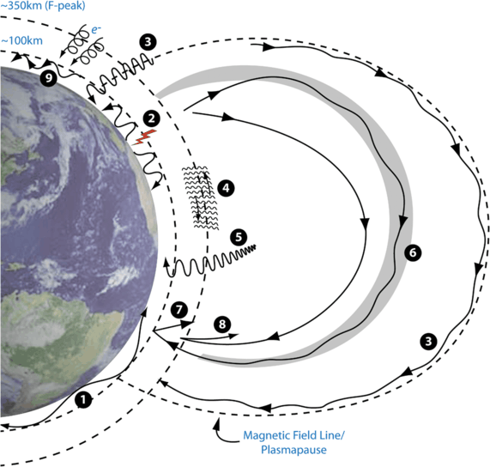
Waves in the Earth-atmosphere-ionosphere-magnetosphere

Slide 4
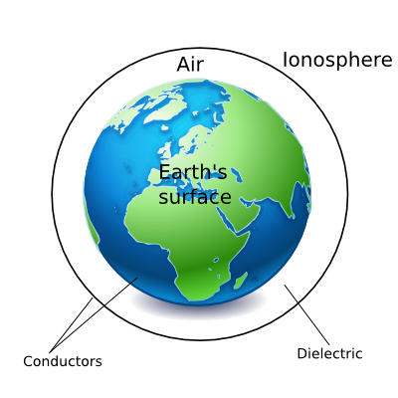
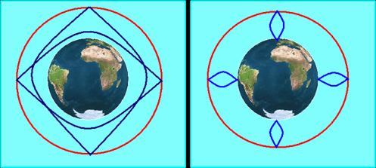
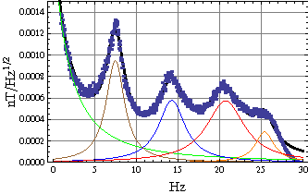
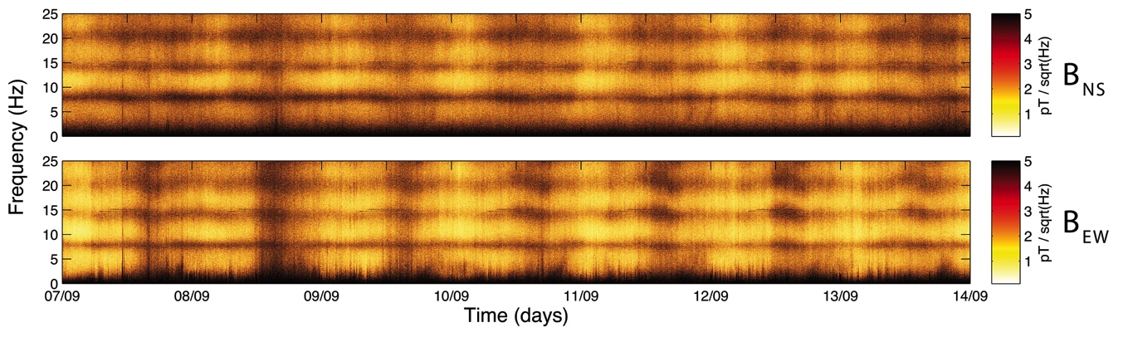
Planet - ionosphere cavity: Schumann resonances
Two eigen-modes: Schumann resonances and atmospherics

Slide 5
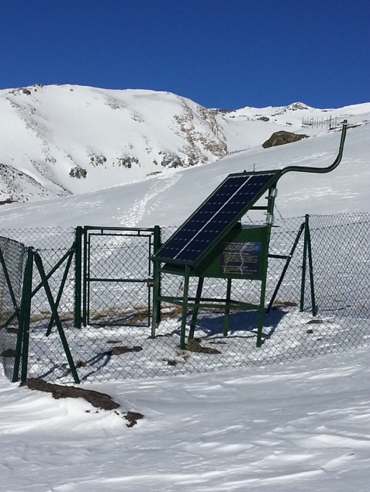
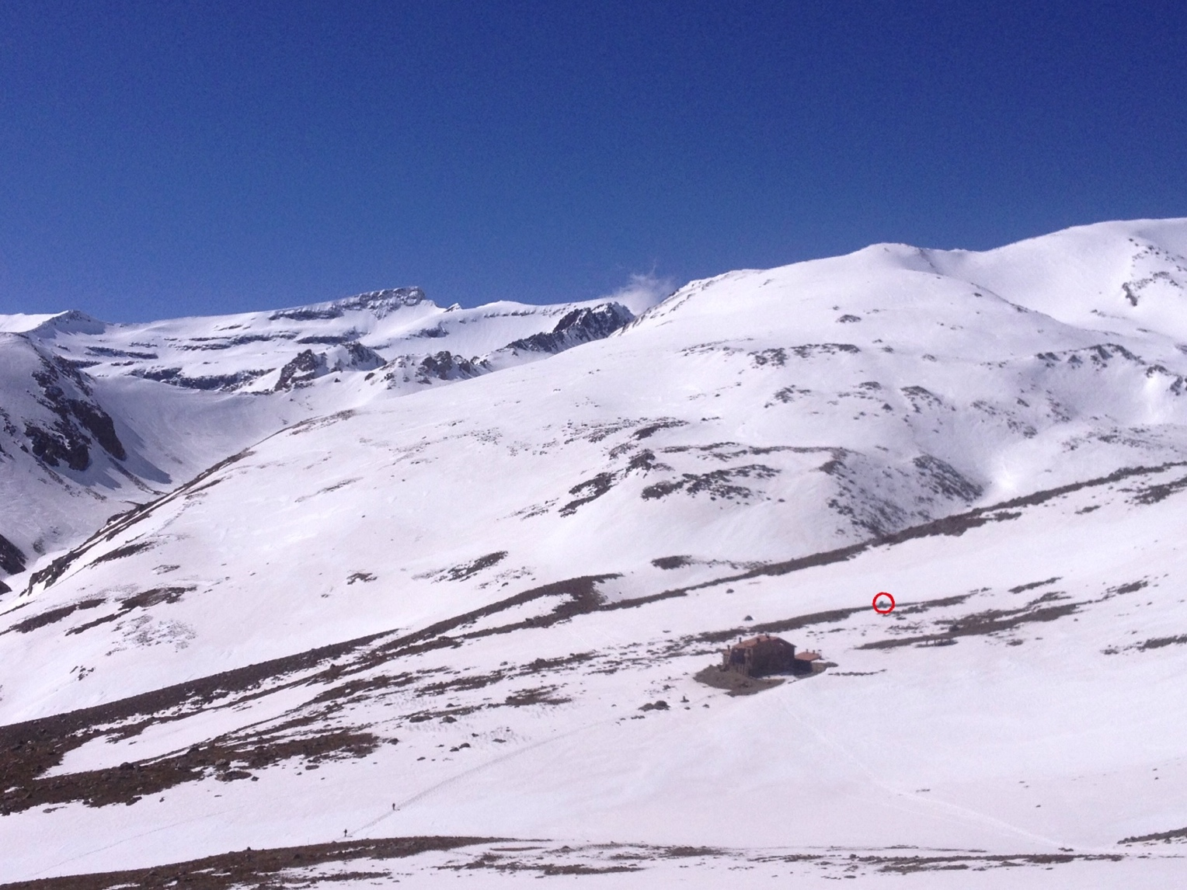
Schumann resonance measurements at Earth
Sierra Nevada station, Granada, Spain. 2500 m above sea level.

Slide 6
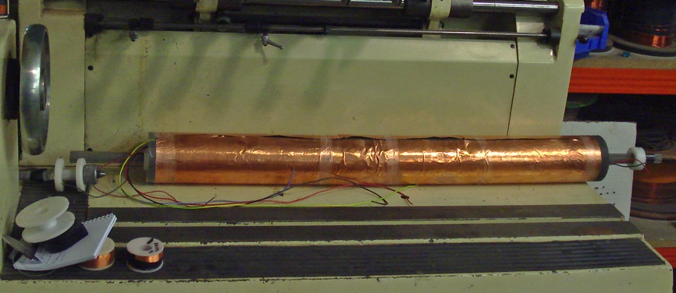
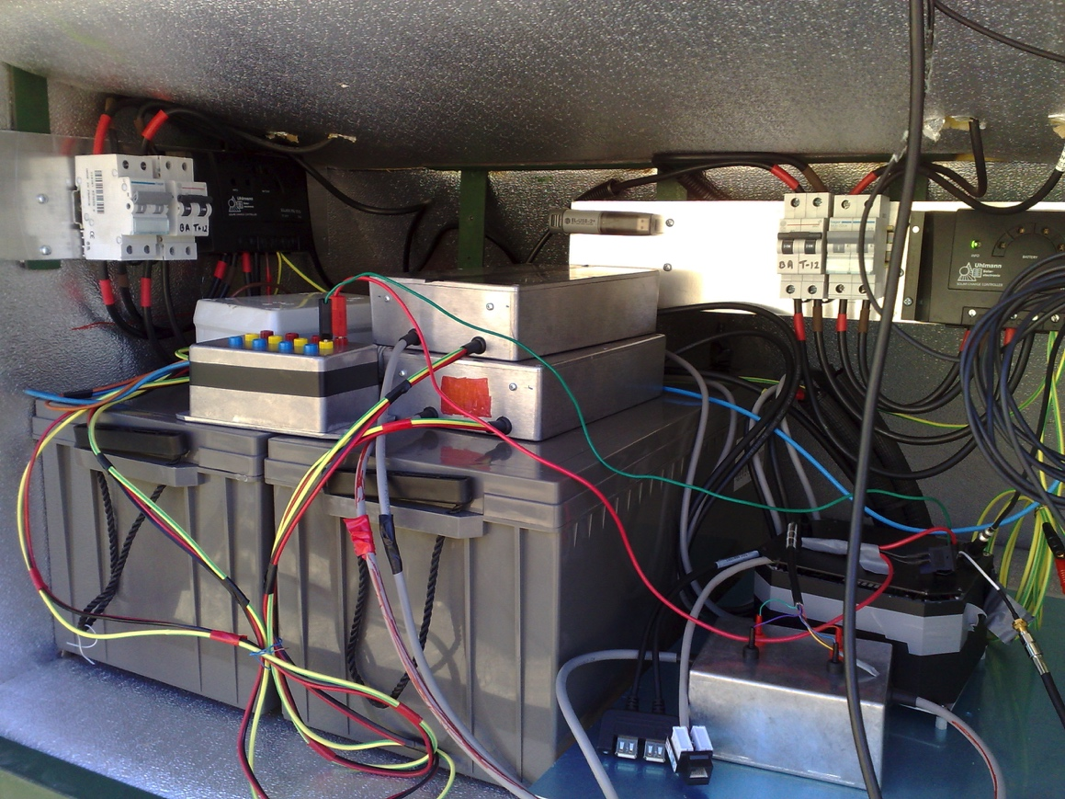
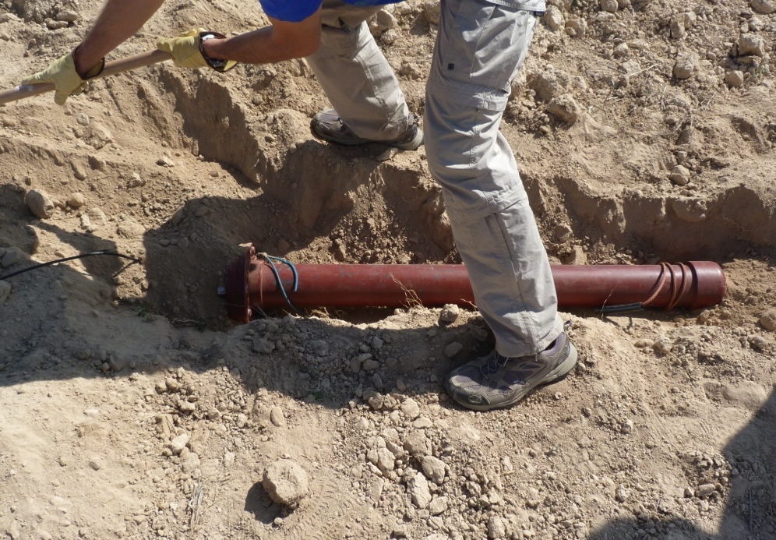
Juan Antonio Morente ELF station, Sierra Nevada, Granada Spain

Slide 7
2013 St. Patrick 'Day solar storm

Slide 8
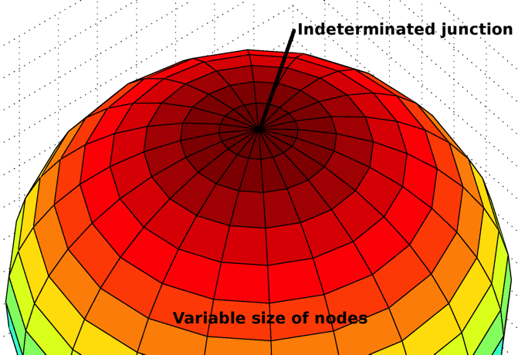
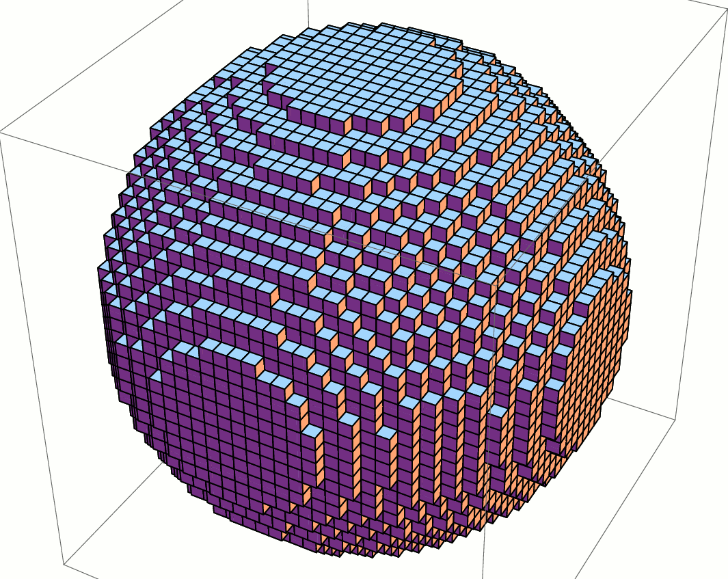
The Transmission Line Matrix method
Spherical TLM
Cartesian TLM
S. Resonances previously studied using TLM or FDTD in spherical coordinates
5x500x500 km nodes
10⁴ total nodes.
Advantage: low-cost computations.
TLM model
5x5x5 km nodes,
10⁸ total nodes.
Advantages: no TLM dispersion, 100 times better resolution in phi and theta. BUT computationally expensive.

Slide 9
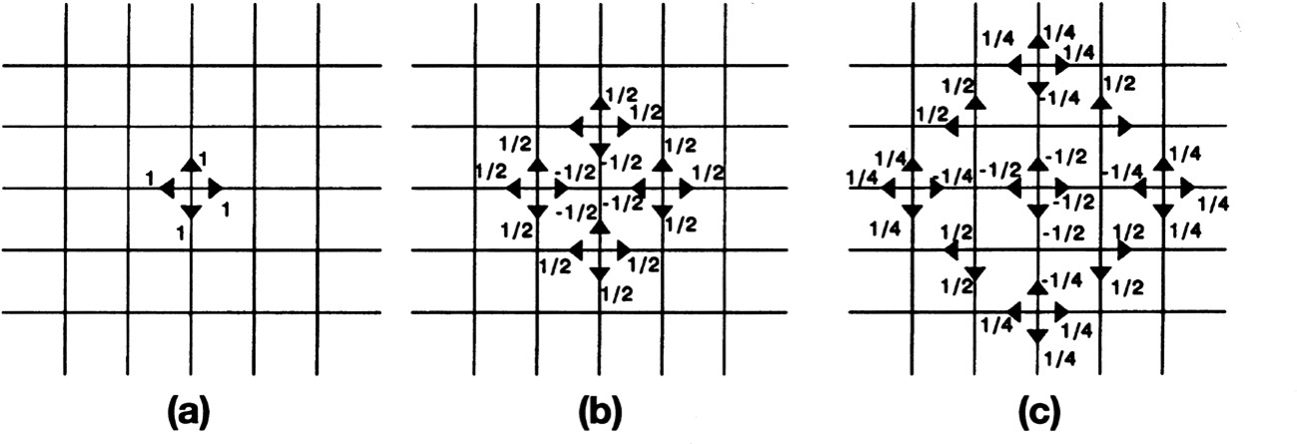
Transmission Line Matrix (TLM) method
The TLM is a numerical method, devised in time domain, which approaches the problem to solve by defining a transmission line circuit which behaves in a similar manner, i.e. is governed by the same differential equations. The time and space are discretized, and a cell unit or TLM node is assigned to each differential of volume.
Evolution of the pulses traveling in a TLM mesh.

Slide 10
Lumped element representations of the i-series and i-parallel circuits

Slide 11
Effect of the losses over Schumann resonance
Fixed conductivities
Earth-ionosphere conductivity profile

Slide 12
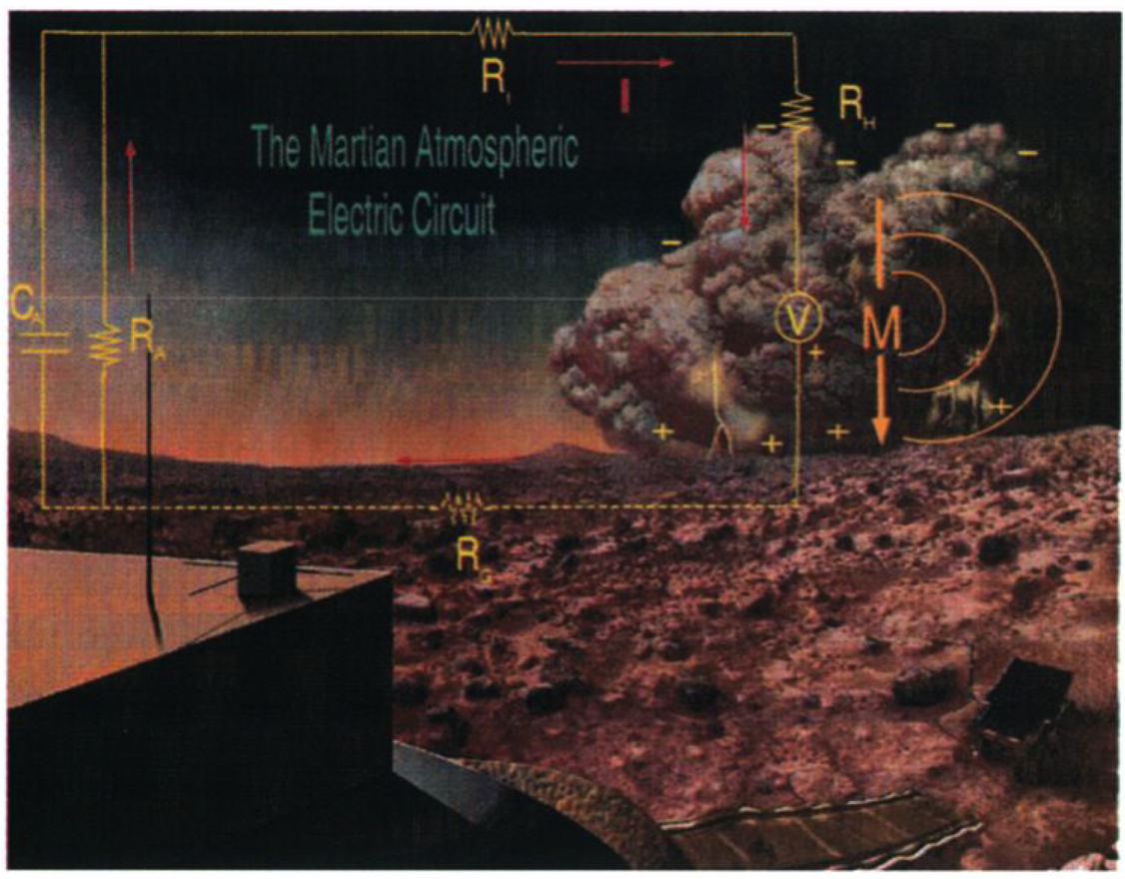
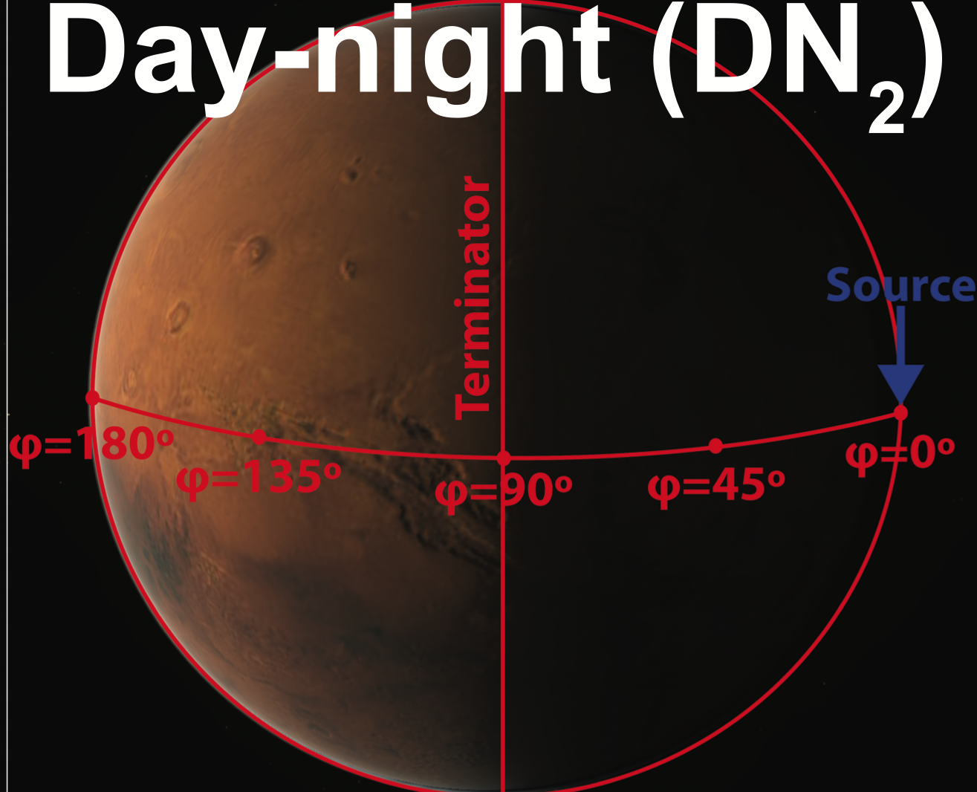
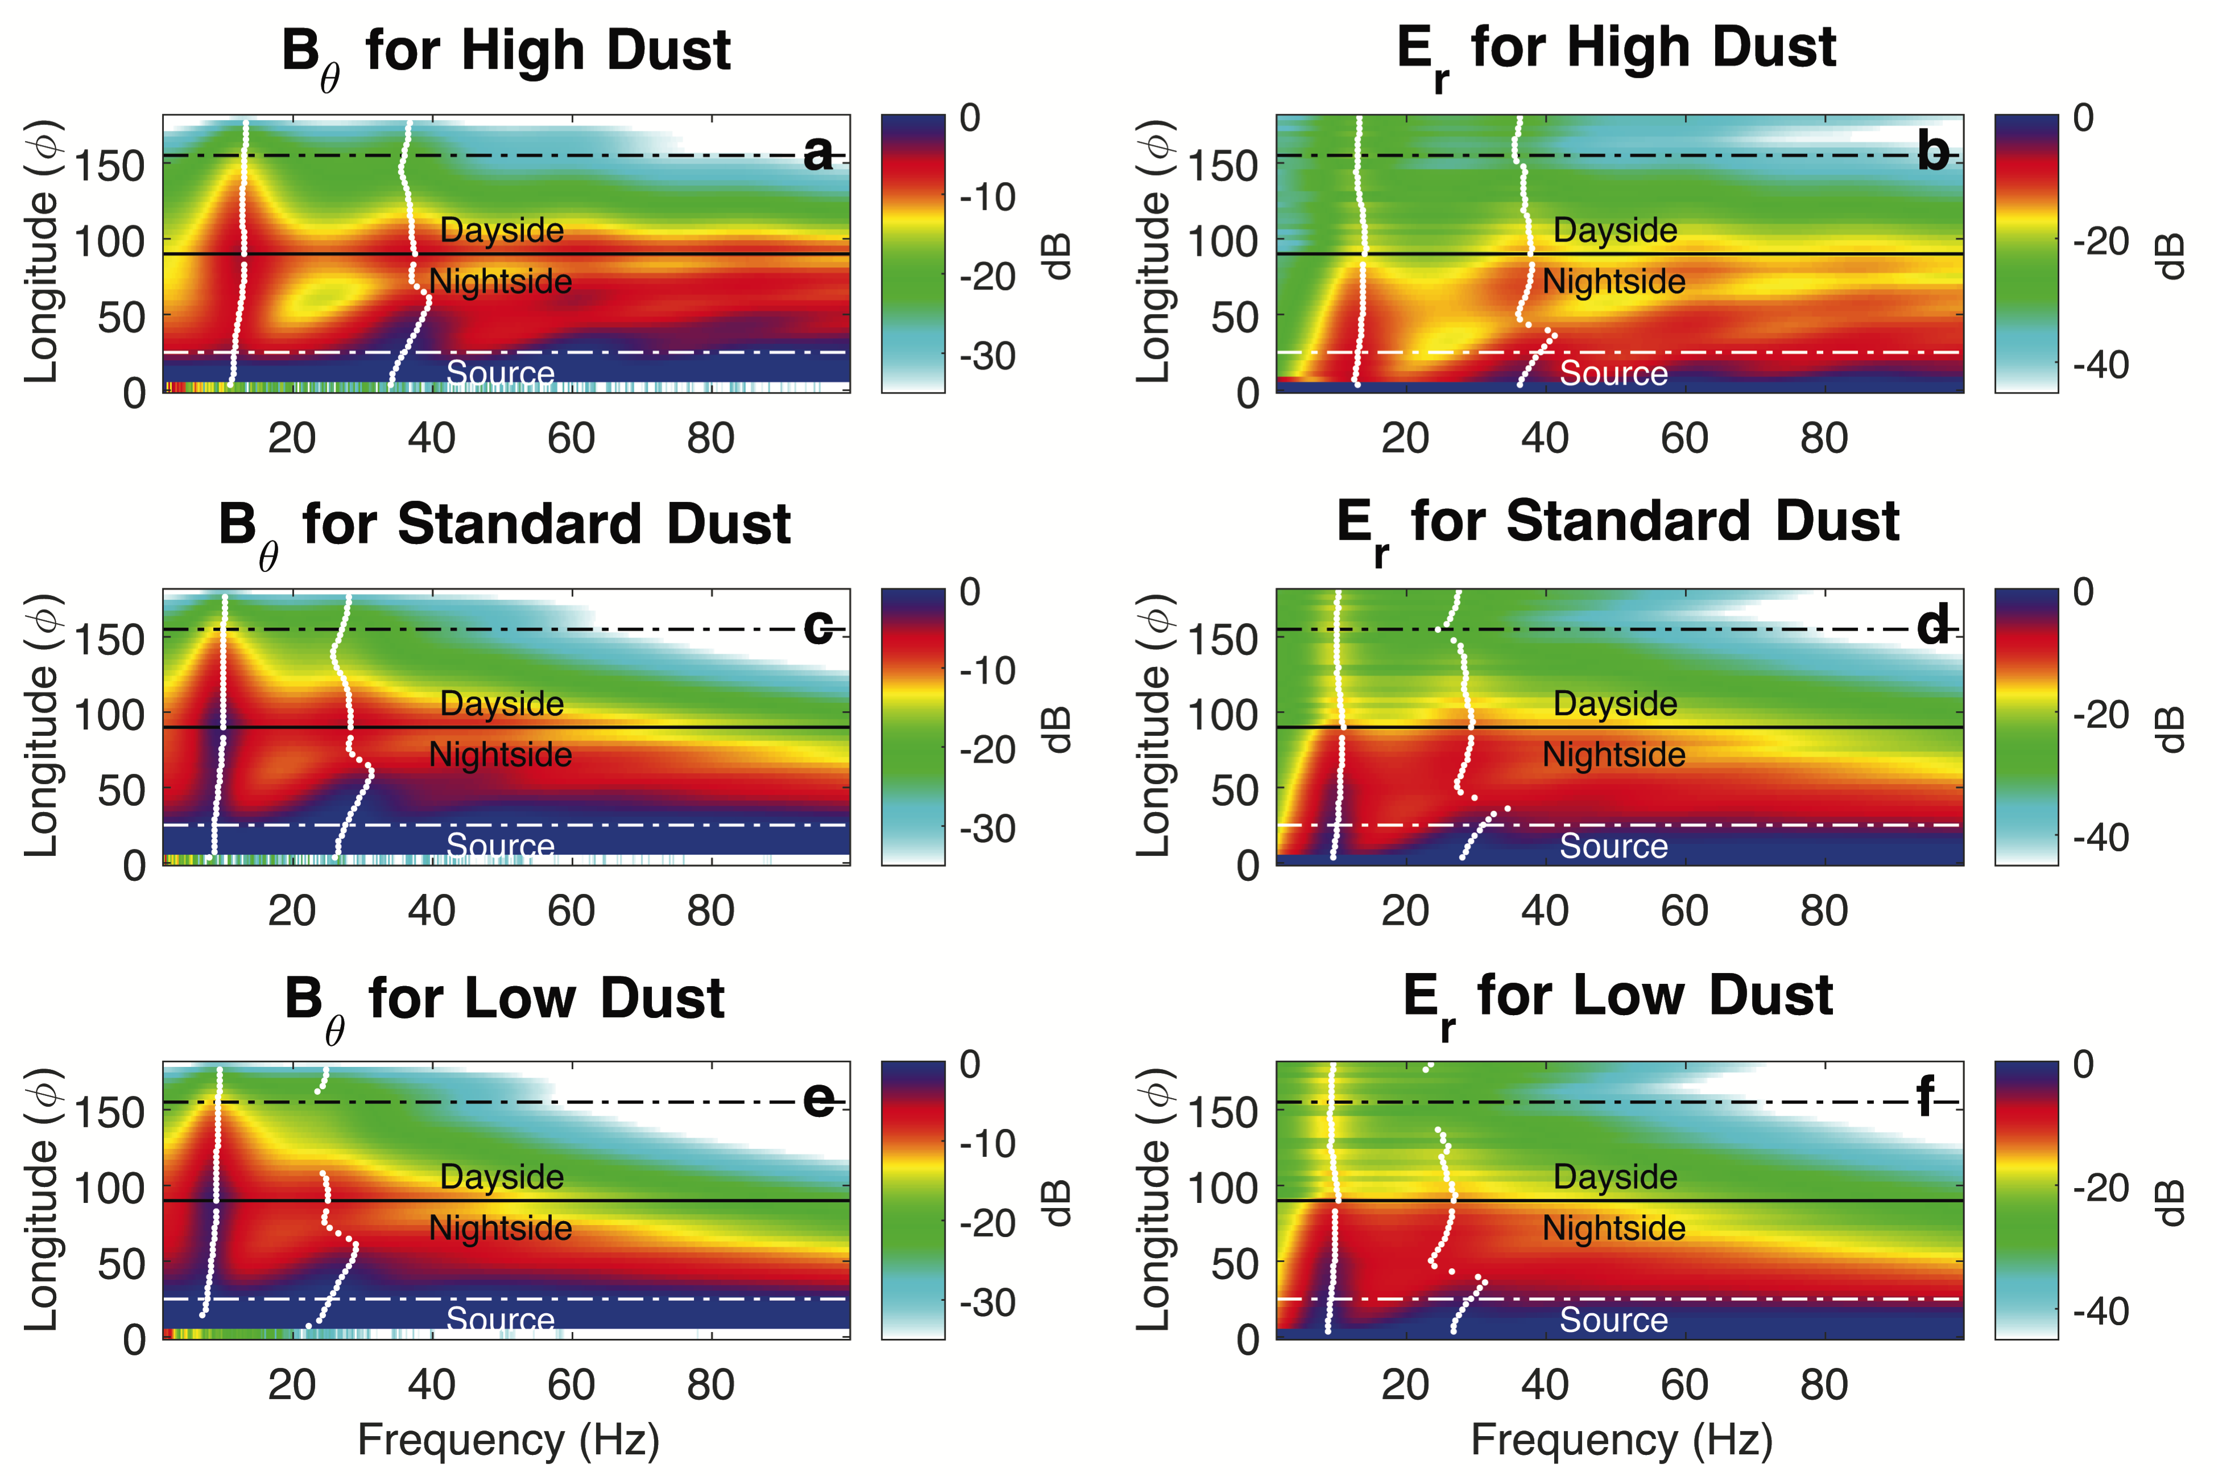
ExoMars - ESA

